Slide 1


























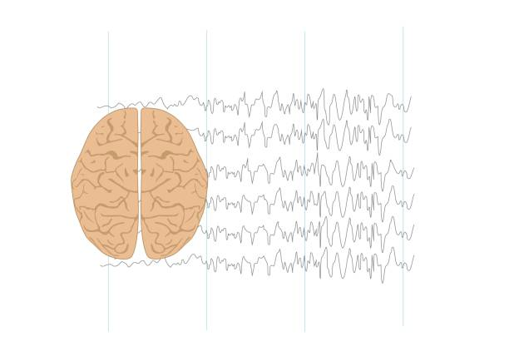



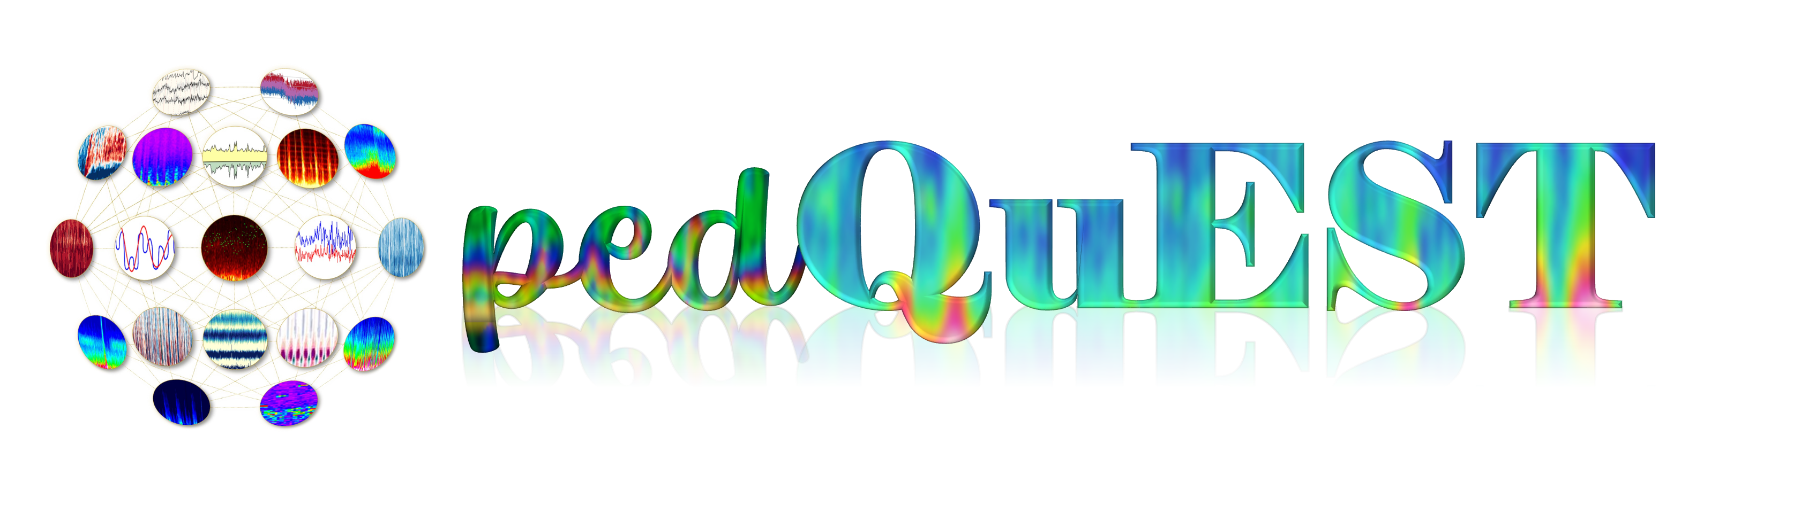
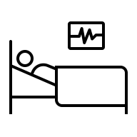






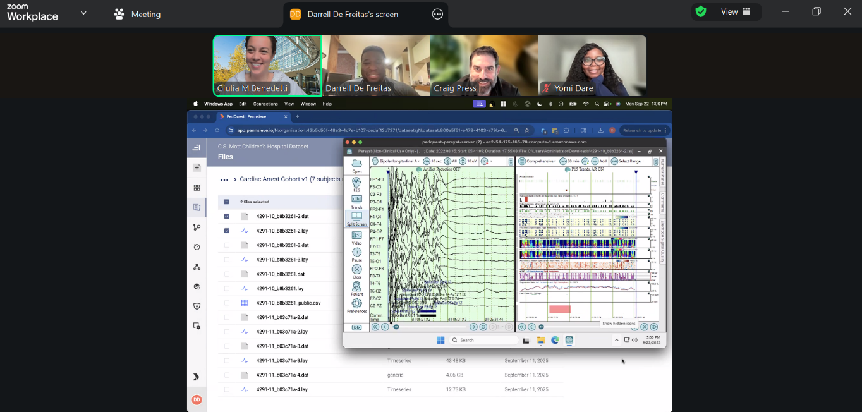

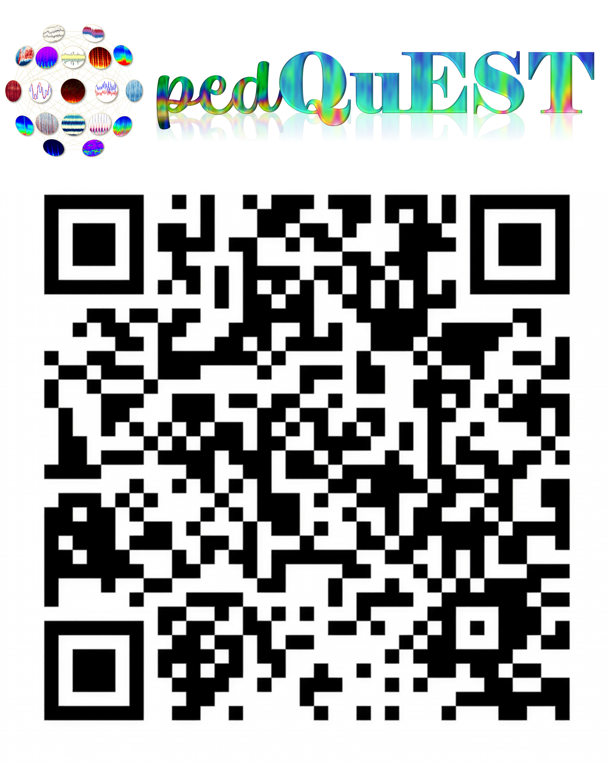

Development of a multicenter EEG research consortium and data platform to advance Pediatric Quantitative EEG Research
Craig A. Press*¹, Giulia M. Benedetti*², Dana B. Harrar³, Raquel Farias-Moeller⁴, Stuart Tomko⁵, Anuj Jayakar⁶, Brian Appavu⁷,
Lindsay A. Morgan⁸, Carlos Castillo-Pinto⁸, Ajay X. Thomas⁹, Daniel Davila-Williams⁹, Stephanie MD Rau², Maelyn Fulton², Darshana Parikh¹,
Nicholas S. Abend¹, Cecil Hahn¹⁰, James Riviello⁹, Saptharishi Lalgudi Ganesan¹¹, Darrell De Freitas¹², Yomi Dare¹², Joost Wagenaar¹²
1. Children’s Hospital of Philadelphia, University of Pennsylvania; 2. C. S. Mott Children’s Hospital, University of Michigan; 3. Children’s National Hospital, George Washington University School of Medicine; 4. Children’s Wisconsin, Medical College of Wisconsin; 5. St. Louis Children’s Hospital, Washington University School of Medicine; 6. Nicklaus Children’s Hospital; 7. Phoenix Children’s Hospital, University of Arizona College of Medicine Phoenix; 8. Seattle Children’s Hospital, University of Washington; 9. Texas Children’s Hospital, Baylor College of Medicine; 10. The Hospital for Sick Children, University of Toronto; 11. Children’s Hospital at London Health Sciences Centre, Western University; 12. University of Pennsylvania.
RATIONALE
RESULTS
Electroencephalography (EEG) is the most commonly used tool for acute brain monitoring. Quantitative EEG (qEEG) allows quantitative analysis, visualization, and bedside display of EEG data. Challenges to EEG research include de-identification of EEG files, inefficient system to share EEGs, lack of secure data platforms for waveform and clinical data, and non-standardized analytic pipelines.
Figure 1: PedQuEST Data and Regulatory Management
Figure 2: PedQuEST Data Management Plan
Central IRB
Reliance agreements from each site
Copy EEG Files Encrypted
local Research storage
Upload deidentified EEGs
to Pennsieve AWS cloud
Central Consortium Agreement and Data Coordinating Center
Access
Site Research Team:
Access to own site datasets for data verification, cleaning, and analysis.
Site 1 Bucket
Site 2 Bucket
Site 3 Bucket
Sites 4 +…
Sites
Transfer
Access
Each member site
identifies patients meeting
inclusion criteria
Batch de-identify and convert files
to standardized Persyst *.Lay format
Limited Clinical Dataset
Extracted from EMR
PHI limited to dates/times
Fully Deidentified Clinical Data
Access
Access
Accessible by Site 1
Accessible by Site 2
Accessible by Site 3
METHODS
Transfer
Pennsieve Research Team + pedQuEST PIs, Scientific Committee, and Designated staff
Access to full datasets for data verification, cleaning, and distribution
Limited Clinical Dataset
Extracted from EMR
to local database
De-identified clinical data mapped to EEGs uploaded to Pennsieve
PedQuEST PIs and Coordinators
10 large pediatric academic centers convened to create a consortium to develop infrastructure for creating:
Regulatory infrastructure connected to and managed within the research consortium, the Pediatric Quantitative EEG Strategic Taskforce (PedQuEST);
Data extraction pipeline automating EEG data collection, deidentification, and transfer;
State-of-the-art research platform for EEG storage and analysis linked to clinical data.
Coded data with identifiers:
Medical Record Number
Full Name
Date of Birth
Study ID
EEG File Names
Access
Transfer
PedQuEST Scientific Committee review and approval of project proposals
Clinical and EEG data will be linked with quality and deidentification verification
Deidentified EEG Files*
Access
Approved research team using Pennsieve:
Access to multisite de-identified dataset for analysis through Pennsieve
Fully Deidentified Clinical and EEG Data
Transfer
Researchers propose projects and request datasets for external analysis or centralized analysis pipelines
In development
*At a future date where Pennsieve is covered by HIPAA protections, the limited PHI including dates from Michigan and sites may be transferred. This will allow date shifting to be performed in the same platform and avoid the risk of misaligned data.
De-identified data transferred to investigators for analysis
Custom
Analysis
PersystTM
Cloud
Multicenter Data
Approved research team analyzing data external to Pennsieve
🟧 Orange = Identified data or Limited Dataset
🟦 Blue = De-identified
🟩 Green = Multicenter / Aggregated Data
🟪 Purple = PedQuEST Governance
🟥 Red = Fully De-identified External Export
Pennsieve built in cloud-based analytics and visualization using Persyst and AWS cloud computing in Pennsieve and custom internal analysis
External analysis consistent with data sharing agreements
qEEG visualization and review
RESULTS
CONCLUSIONS
Regulatory:
Centralized IRB and data-sharing agreement across 10 sites (Fig. 1)
Governance for current and future projects
Scientific Committee evaluates proposals and oversee studies
Rapid site onboarding and new study activation
Mentorship and regulatory support for investigators using PedQuEST.
Data Extraction Pipeline:
Python-based pipeline using Persyst (15b, Research) on virtual compute nodes indexes all clinical EEGs and metadata
Standardized de-identification and format conversion (*.lay,*.dat) for all sites.
Preserves timestamps with date shifting while allowing realignment using days from birth
Persyst “flat” layout ensures compatibility with clinical and research analytic platforms.
Data integrity verified during transfer process
Data Platform:
Collaborating with the Wagenaar lab, PedQuEST @ Pennsieve is a cloud system for multisite data curation, integration, and analysis (Fig 2).
Investigators to access their own data securely and explore multisite datasets.
Supports analytic pipelines and external data sharing.
Developing centralized custom pipelines
Clinical-platform processing and collaboration will enable rapid translation of qEEG research to bedside care.
Examples and Use Cases
All sites have virtual machines to process EEGs running PedQuEST software
8/9 sites have uploaded data
First data connection created at BCM-TCH
Processed ~3.5K EEGs from 350 patients, ~3.75TB of data with minimal interaction over 4 days (<4hrs of work) vs. ~3.6 months of 40/hr/week effort assuming 10min/file
Infrastructure supporting both a K-Award and PERF grant – subsequently added new site to IRB and consortium
Two additional grants submitted using PedQuEST infrastructure
Local nodes have processed hundreds of patient EEGs for local studies
Virtual Cloud based access to fully deidentified EEG for visualization across sites and centrally.
The development of a multicenter EEG data platform with efficient large scale data sharing and IRB regulatory approval for pilot and future studies eliminates many of the obstacles that have hindered pediatric EEG and qEEG research while maintaining data safety and integrity. The structure and governance will enable research that requires many subjects and EEG files from multicenter collaborations.
Funding and Acknowledgements
The Pediatric Epilepsy Research Foundation funded this work through their Grant for Infrastructure.
We also appreciate the support provided from Persyst, Michael Guess, Mark Sheuer, Nicolas Nierenberg, and Kady Colabrese, assisting with the ability to use software to universally read EEG formats and standardized file conversion.

Slide 2

Development of a multicenter EEG research consortium and data platform to advance Pediatric Quantitative EEG Research
Craig A. Press*¹, Giulia M. Benedetti*², Dana B. Harrar³, Raquel Farias-Moeller⁴, Stuart Tomko⁵, Anuj Jayakar⁶, Brian Appavu⁷,
Lindsay A. Morgan⁸, Carlos Castillo-Pinto⁸, Ajay X. Thomas⁹, Stephanie MD Rau², Maelyn Fulton², Darshana Parikh¹,
Nicholas S. Abend¹, Cecil Hahn¹⁰, James Riviello⁹, Rishi Ganesan¹¹, Darrell De Freitas¹², Yomi Dare¹², Joost Wagenaar¹²
1. Children’s Hospital of Philadelphia, University of Pennsylvania; 2. C. S. Mott Children’s Hospital, University of Michigan; 3. Children’s National Hospital, George Washington University School of Medicine; 4. Children’s Wisconsin, Medical College of Wisconsin; 5. St. Louis Children’s Hospital, Washington University School of Medicine; 6. Nicklaus Children’s Hospital; 7. Phoenix Children’s Hospital, University of Arizona College of Medicine Phoenix; 8. Seattle Children’s Hospital, University of Washington; 9. Texas Children’s Hospital, Baylor College of Medicine; 10. The Hospital for Sick Children, University of Toronto; 11. Children’s Hospital at London Health Sciences Centre, Western University; 12. University of Pennsylvania.
RATIONALE
RESULTS
Electroencephalography (EEG) is the most commonly used tool for acute brain monitoring. Quantitative EEG (qEEG) allows quantitative analysis, visualization, and bedside display of EEG data. Challenges to EEG research include de-identification of EEG files, inefficient system to share EEGs, lack of secure data platforms for waveform and clinical data, and non-standardized analytic pipelines.
Figure 1: PedQuEST Data and Regulatory Management
Figure 2: PedQuEST Data Management Plan
Central IRB
Reliance agreements from each site
Copy EEG Files Encrypted
local Research storage
Upload deidentified EEGs
to Pennsieve AWS cloud
Central Consortium Agreement and Data Coordinating Center
Access
Site Research Team:
Access to own site datasets for data verification, cleaning, and analysis.
Site 1 Bucket
Site 2 Bucket
Site 3 Bucket
Sites 4 +…
Sites
Transfer
Each member site
identifies patients meeting
inclusion criteria
Batch de-identify and convert files
to standardized Persyst *.Lay format
Access
Accessible by Site 1
Accessible by Site 2
Accessible by Site 3
Limited Clinical Dataset
Extracted from EMR
PHI limited to dates/times
Fully Deidentified Clinical Data
Access
Access
Limited Clinical Dataset
Extracted from EMR
to local database
De-identified clinical data mapped to EEGs uploaded to Pennsieve
METHODS
Transfer
Pennsieve Research Team + pedQuEST PIs, Scientific Committee, and Designated staff
Access to full datasets for data verification, cleaning, and distribution
PedQuEST PIs and Coordinators
10 large pediatric academic centers convened to create a consortium to develop infrastructure for creating:
Regulatory infrastructure connected to and managed within the research consortium, the Pediatric Quantitative EEG Strategic Taskforce (PedQuEST);
Data extraction pipeline automating EEG data collection, deidentification, and transfer;
State-of-the-art research platform for EEG storage and analysis linked to clinical data.
Coded data with identifiers:
Medical Record Number
Full Name
Date of Birth
Study ID
EEG File Names
Access
Clinical and EEG data will be linked with quality and deidentification verification
Transfer
PedQuEST Scientific Committee review and approval of project proposals
Deidentified EEG Files*
Access
Approved research team using Pennsieve:
Access to multisite de-identified dataset for analysis through Pennsieve
In development
Fully Deidentified Clinical and EEG Data
Researchers propose projects and request datasets for external analysis or centralized analysis pipelines
Custom
Analysis
PersystTM
Cloud
Multicenter Data
Transfer
Pennsieve built in cloud-based analytics and visualization using Persyst and AWS cloud computing in Pennsieve and custom internal analysis
*At a future date where Pennsieve is covered by HIPAA protections, the limited PHI including dates from Michigan and sites may be transferred. This will allow date shifting to be performed in the same platform and avoid the risk of misaligned data.
De-identified data transferred to investigators for analysis
🟧 Orange = Identified data or Limited Dataset
🟦 Blue = De-identified
🟩 Green = Multicenter / Aggregated Data
🟪 Purple = PedQuEST Governance
🟥 Red = Fully De-identified External Export
External analysis consistent with data sharing agreements
qEEG visualization and review
Approved research team analyzing data external to Pennsieve
RESULTS
CONCLUSIONS
Regulatory:
We developed a data sharing agreement and centralized IRB protocol that created the legal and regulatory structure for data sharing between 10 sites, a data coordinating center, and a research platform (Fig 1).
The agreement outlines:
Data governance for current/future projects
Defines a Scientific Committee for evaluating and approving studies using consortium data to ensure data safety and high-quality research.
Creates pathways for adding new sites and future studies
Our Scientific Committee supports scientific project proposals with mentorship and advisory support for investigators embarking on pediatric qEEG research.
Data Extraction Pipeline:
The pipeline uses Persyst (15b, Research) and Python scripts on a virtual or local server enabling indexing of all clinical EEGs with EEG metadata.
EEGs meeting study criteria are identified and stored in Persyst format as date-shifted, deidentified files.
Preserves time alignment without dates using days from birth for each EEG
Persyst file format (*.lay, *.dat) enables both research and clinical platforms analysis.
Files are uploaded with verified data integrity to the Pennsieve platform.
Data Platform:
Pennsieve is a cloud-based multi-tenant platform for scientific data collaboration, integration, and analysis created by the Wagenaar lab (Fig 2).
Data management tools allow investigators to:
Access their own data securely
Aggregate multisite data
Analyze or package data for approved external analysis
Centralized analytic custom pipelines
Commercial clinical platform processing for rapid translation of research to the bedside
Examples and Use Cases
All sites have virtual machines to process EEGs running PedQuEST software
8/9 sites have uploaded data
First data connection created at BCM-TCH
One site processed ~3.5K EEGs from 350 patients, ~3.75TB of data with minimal interaction over 4 days (<4hrs of work) vs. ~3.6 months of 40/hr/week effort assuming 10min/file
Infrastructure supporting both a K-Award and PERF grant – subsequently added new site to IRB and consortium
Two additional grants submitted using PedQuEST infrastructure
Local infrastructure used to process hundreds of patient EEGs for local study
The development of a multicenter EEG data platform with efficient large scale data sharing and IRB regulatory approval for pilot and future studies eliminates many of the obstacles that have hindered pediatric EEG and qEEG research while maintaining data safety and integrity. The structure and governance will enable research that requires many subjects and EEG files from multicenter collaborations.
Funding and Acknowledgements
The Pediatric Epilepsy Research Foundation funded this work through their Grant for Infrastructure.
We also appreciate the support provided from Persyst, Michael Guess, Mark Sheuer, Nicolas Nierenberg, and Kady Colabrese, assisting with the ability to use software to universally read EEG formats and standardized file conversion.

